Slide 1
Vector Semantics part 2

Slide 2
Tf-idf and PPMI are sparse representations
tf-idf and PPMI vectors are
long (length |V|= 20,000 to 50,000)
sparse (most elements are zero)

Slide 3
Alternative: dense vectors
vectors which are
short (length 50-1000)
dense (most elements are non-zero)

Slide 4
Sparse versus dense vectors
Why dense vectors?
Short vectors may be easier to use as features in machine learning (fewer weights to tune)
Dense vectors may generalize better than storing explicit counts
They may do better at capturing synonymy:
car and automobile are synonyms; but are distinct dimensions in sparse vectors
a word with car as a neighbor and a word with automobile as a neighbor should be similar, but aren't
In practice, they work better

Slide 5

Dense embeddings you can download!
Word2vec (Mikolov et al.)
https://code.google.com/archive/p/word2vec/
Fasttext http://www.fasttext.cc/
Glove (Pennington, Socher, Manning)
http://nlp.stanford.edu/projects/glove/
Magnitude (Patel and Sands)
https://github.com/plasticityai/magnitude

Slide 6
Word2vec
Popular embedding method
Very fast to train
Code available on the web
Idea: predict rather than count

Slide 7
Word2vec
Instead of counting how often each word w occurs near "apricot"
Train a classifier on a binary prediction task:
Is w likely to show up near "apricot"?
We don’t actually care about this task
But we'll take the learned classifier weights as the word embeddings
Notes:
The intuition of word2vec is that instead of counting how often each word w oc- curs near, say, apricot, we’ll instead train a classifier on a binary prediction task: “Is word w likely to show up near apricot?” We don’t actually care about this prediction task; instead we’ll take the learned classifier weights as the word embeddings.

Slide 8
Brilliant insight
Use running text as implicitly supervised training data!
A word s near apricot
Acts as gold ‘correct answer’ to the question
“Is word w likely to show up near apricot?”
No need for hand-labeled supervision
The idea comes from neural language modeling (Bengio et al. 2003))
Notes:
This idea was first proposed in the task of neural language modeling, when Bengio et al. (2003) and Collobert et al. (2011) showed that a neural language model (a neural network that learned to predict the next word from prior words) could just use the next word in running text as its supervision signal, and could be used to learn an embedding representation for each word as part of doing this prediction task.
We’ll see how to do neural networks in the next chapter, but word2vec is a much simpler model than the neural network language model, in two ways. First, word2vec simplifies the task (making it binary classification instead of word pre- diction). Second, word2vec simplifies the architecture (training a logistic regression classifier instead of a multi-layer neural network with hidden layers that demand more sophisticated training algorithms). The intuition of skip-gram is:

Slide 9
Word2Vec: Skip-Gram Task
Word2vec provides a variety of options. Let's do
"skip-gram with negative sampling" (SGNS)
Notes:
The revolutionary intuition here is that we can just use running text as implicitly supervised training data for such a classifier; a word s that occurs near the target word apricot acts as gold ‘correct answer’ to the question “Is word w likely to show up near apricot?” This avoids the need for any sort of hand-labeled supervision signal.

Slide 10
Skip-gram algorithm
Treat the target word and a neighboring context word as positive examples.
Randomly sample other words in the lexicon to get negative samples
Use logistic regression to train a classifier to distinguish those two cases
Use the weights as the embeddings

Slide 11
Skip-Gram Training Data
Training sentence:
... lemon, a tablespoon of apricot jam a pinch ...
c1 c2 target c3 c4
Assume context words are those in +/- 2 word window

Slide 12
Skip-Gram Goal
Given a tuple (t,c) = target, context
(apricot, jam)
(apricot, aardvark)
Return probability that c is a real context word:
P(+|t,c)
P(−|t,c) = 1−P(+|t,c)
Notes:
T = target, c = context
Our goal is to train a classifier such that, given a tuple (t,c) of a target word t paired with a candidate context word c (for example (apricot, jam), or perhaps (apricot, aardvark) it will return the probability that c is a real context word (true for jam, false for aardvark): P(+|t , c)
The probability that word c is not a real context word for t is just 1 minus that. P(−|t,c) = 1−P(+|t,c)

Slide 13
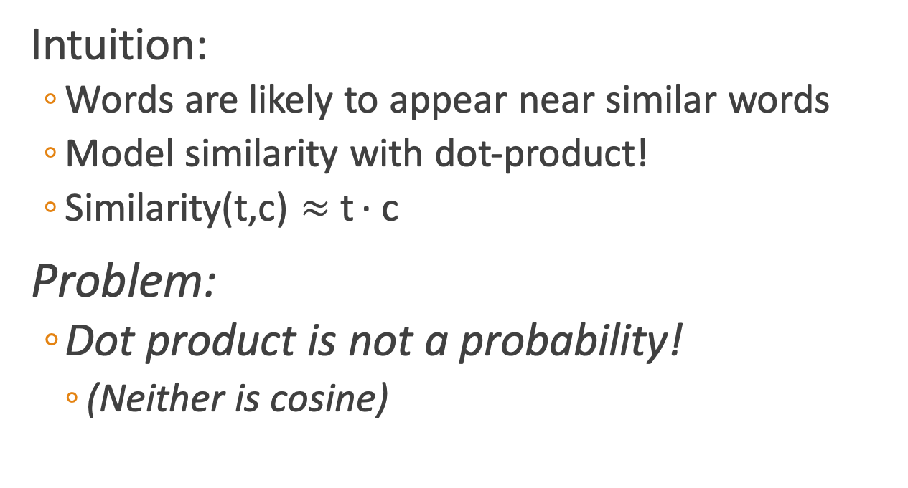
How to compute p(+|t,c)?
Intuition:
Words are likely to appear near similar words
Model similarity with dot-product!
Similarity(t,c) $≈$t ∙ c
Problem:
Dot product is not a probability!
(Neither is cosine)
Notes:
T = target, c = context
How does the classifier compute the probability P? The intuition of the skip- gram model is to base this probability on similarity: a word is likely to occur near the target if its embedding is similar to the target embedding. How can we compute similarity between embeddings? Recall that two vectors are similar if they have a high dot product (cosine, the most popular similarity metric, is just a normalized dot product). In other words: Similarity(t,c)≈t·c
Of course, the dot product t · c is not a probability, it’s just a number ranging from −∞ to ∞.
(Cosine is the dot product, divided by the vetor lengths of v and w)

Slide 14
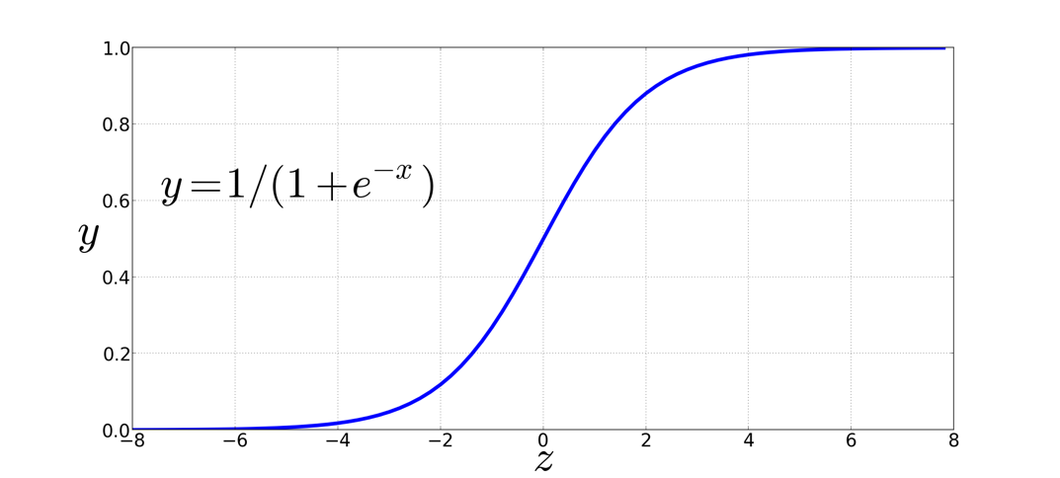
Turning dot product into a probability
The sigmoid lies between 0 and 1:
Notes:
The sigmoid function just returns a number between 0 and 1, so to make it a proba- bility we’ll need to make sure that the total probability of the two possible events (c being a context word, and c not being a context word) sum to 1.

Slide 15
Turning dot product into a probability
Notes:
The probability that word c is not a real context word for t is thus

Slide 16
Turning dot product into a probability
Notes:
The probability that word c is not a real context word for t is thus

Slide 17
For all the context words:
Assume all context words are independent
Notes:
That gives us the probability for one word, but we need to take account of the multiple context words in the window. Skip-gram makes the strong but very useful simplifying assumption that all context words are independent, allowing us to just multiply their probabilities.
In summary, skip-gram trains a probabilistic classifier that, given a test target word t and its context window of k words c1:k, assigns a probability based on how similar this context window is to the target word. The probability is based on applying the logistic (sigmoid) function to the dot product of the embeddings of the target word with each context word. We could thus compute this probability if only we had embeddings for each word target and context word in the vocabulary.

Slide 18
For all the context words:
Assume all context words are independent
Notes:
That gives us the probability for one word, but we need to take account of the multiple context words in the window. Skip-gram makes the strong but very useful simplifying assumption that all context words are independent, allowing us to just multiply their probabilities.
In summary, skip-gram trains a probabilistic classifier that, given a test target word t and its context window of k words c1:k, assigns a probability based on how similar this context window is to the target word. The probability is based on applying the logistic (sigmoid) function to the dot product of the embeddings of the target word with each context word. We could thus compute this probability if only we had embeddings for each word target and context word in the vocabulary.

Slide 19
Popping back up
Now we have a way of computing the probability of p(+|t,c), which is the probability that c is a real context word for t.
But, we need embeddings for t and c to do it.
Where do we get those embeddings?
Word2vec learns them automatically!
It starts with an initial set of embedding vectors and then iteratively shifts the embedding of each word w to be more like the embeddings of words that occur nearby in texts, and less like the embeddings of words that don’t occur nearby.

Slide 20
Skip-Gram Training Data
Training sentence:
... lemon, a tablespoon of apricot jam a pinch ...
c1 c2 t c3 c4
Training data: input/output pairs centering on apricot
Assume a +/- 2 word window
Notes:
OK, so now we have a way of computing the probability of p(+ | t, c), he probability that c is a real context word for t. BUT, we need embeddings for t and c to do it.

Slide 21
Skip-Gram Training
Training sentence:
... lemon, a tablespoon of apricot jam a pinch ...
c1 c2 t c3 c4
For each positive example, we'll create k negative examples.
Using noise words
Any random word that isn't t

Slide 22
How many noise words?
Training sentence:
... lemon, a tablespoon of apricot jam a pinch ...
c1 c2 t c3 c4
k=2
Notes:
Here k = 2, so we are picking twice as many negative training examples as positive ones.

Slide 23
Choosing noise words
Could pick w according to their unigram frequency P(w)
More common to chosen then according to p_{α}(w)
α= ¾ works well because it gives rare noise words slightly higher probability
To show this, imagine two events p(a)=.99 and p(b) = .01:
Notes:
The noise words are chosen according to their weighted unigram frequency pα (w), where α is a weight. If we were sampling according to unweighted fre- quency p(w), it would mean that with unigram probability p(“the”) we would choose the word the as a noise word, with unigram probability p(“aardvark”) we would
choose aardvark, and so on. But in practice it is common to set α = .75, i.e. use the weighting p^.75 (w)

Slide 24
Learning the classifier
Iterative process.
We’ll start with 0 or random weights
Then adjust the word weights to
make the positive pairs more likely
and the negative pairs less likely
over the entire training set:

Slide 25
Setup
Let's represent words as vectors of some length (say 300), randomly initialized.
So we start with 300 * V random parameters
Over the entire training set, we’d like to adjust those word vectors such that we
Maximize the similarity of the target word, context word pairs (t,c) drawn from the positive data
Minimize the similarity of the (t,c) pairs drawn from the negative data.

Slide 26
Objective Criteria
We want to maximize…
Maximize the + label for the pairs from the positive training data, and the – label for the pairs sample from the negative data.
Notes:
Given the set of positive and negative training instances, and an initial set of embeddings, the goal of the learning algorithm is to adjust those embeddings such that we
• Maximize the similarity of the target word, context word pairs (t,c) drawn from the positive examples
• Minimize the similarity of the (t,c) pairs drawn from the negative examples.

Slide 27
Focusing on one target word t:
Notes:
we want to maximize the dot product of the word with the actual context words, and minimize the dot products of the word with the k negative sampled non-neighbor words.
We can then use stochastic gradient descent to train to this objective, iteratively modifying the parameters (the embeddings for each target word t and each context word or noise word c in the vocabulary) to maximize the objective.

Slide 28
Notes:
The skip-gram model tries to shift embeddings so the target embedding (here for apricot) are closer to (have a higher dot product with) context embeddings for nearby words (here jam) and further from (have a lower dot product with) context embeddings for words that don’t occur nearby (here aardvark).
Note that the skip-gram model thus actually learns two separate embeddings for each word w: the target embedding t and the context embedding c. These embeddings are stored in two matrices, the target matrix T and the context matrix C. So each row i of the target matrix T is the 1 × d vector embedding ti for word i in the vocabulary V , and each column i of the context matrix C is a d × 1 vector embedding ci for word i in V . This figure shows an intuition of the learning task for the embeddings encoded in these two matrices.

Slide 29
Train using gradient descent
Actually learns two separate embedding matrices W and C
Can use W and throw away C, or merge them somehow
Notes:
The learning algorithm starts with randomly initialized W and C matrices, and then walks through the training corpus using gradient descent to move W and C so as to maximize the objective in Eq. 6.34. Thus the matrices W and C function as the parameters θ that logistic regression is tuning.
Once the embeddings are learned, we’ll have two embeddings for each word wi: ti and ci . We can choose to throw away the C matrix and just keep W , in which case each word i will be represented by the vector ti.
Alternatively we can add the two embeddings together, using the summed em- bedding ti + ci as the new d-dimensional embedding, or we can concatenate them into an embedding of dimensionality 2d.

Slide 30
Summary: How to learn word2vec (skip-gram) embeddings
Start with V random 300-dimensional vectors as initial embeddings
Use logistic regression, the second most basic classifier used in machine learning after naïve Bayes
Take a corpus and take pairs of words that co-occur as positive examples
Take pairs of words that don't co-occur as negative examples
Train the classifier to distinguish these by slowly adjusting all the embeddings to improve the classifier performance
Throw away the classifier code and keep the embeddings.
Notes:
Logistic regression is covered in Chapter 5 of the textbook

Slide 31
Evaluating embeddings
Compare to human scores on word similarity-type tasks:
WordSim-353 (Finkelstein et al., 2002)
SimLex-999 (Hill et al., 2015)
Stanford Contextual Word Similarity (SCWS) dataset (Huang et al., 2012)
TOEFL dataset: “levied” is closest in meaning to: (a) imposed, (b) believed, (c) requested, (d) correlated

Slide 32
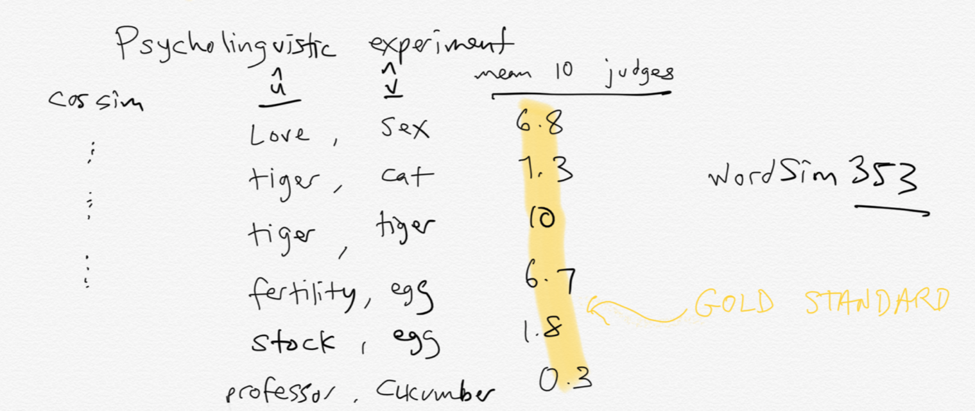
Intrinsic evalation

Slide 33
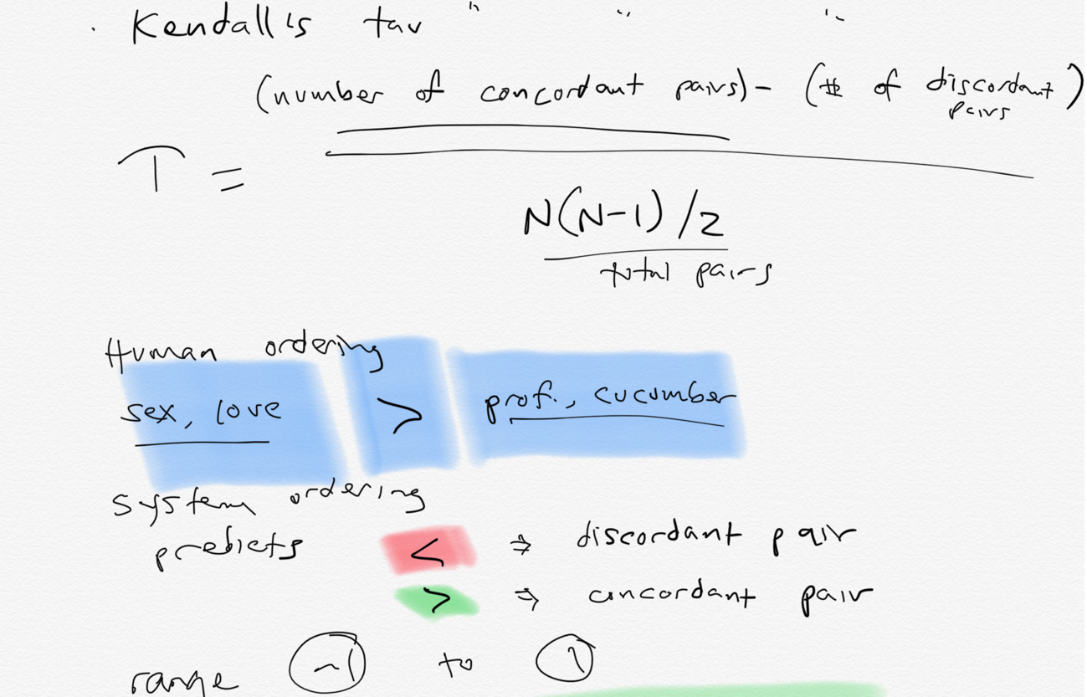
Compute correlation

Slide 34
Properties of embeddings
Similarity depends on window size C
C = ±2 The nearest words to Hogwarts:
Sunnydale
Evernight
C = ±5 The nearest words to Hogwarts:
Dumbledore
Malfoy
halfblood

Slide 35
How does context window change word emeddings?

Slide 36
Solving analogies with embeddings
In a word-analogy task we are given two pairs of words that share a relation (e.g. “man:woman”, “king:queen”).
The identity of the fourth word (“queen”) is hidden, and we need to infer it based on the other three by answering
“man is to woman as king is to — ?”
More generally, we will say a:a∗ as b:b∗.
Can we solve these with word vectors?

Slide 37
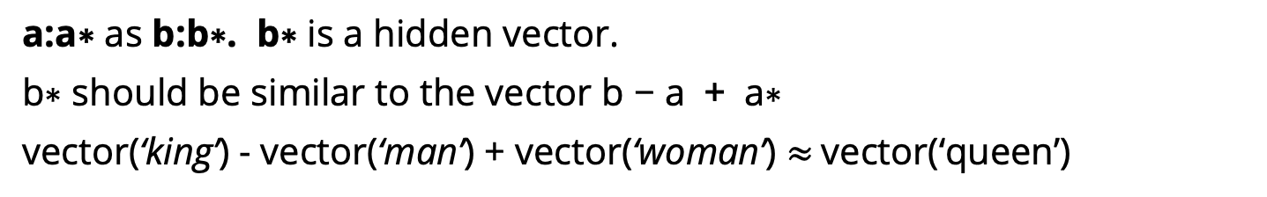
Vector Arithmetic
a:a∗ as b:b∗. b∗ is a hidden vector.
b∗ should be similar to the vector b − a + a∗
vector(‘king’) - vector(‘man’) + vector(‘woman’) $≈$vector(‘queen’)
king
queen
man
woman
Notes:
Analogy Another semantic property of embeddings is their ability to capture re- lational meanings. Mikolov et al. (2013b) and Levy and Goldberg (2014b) show that the offsets between vector embeddings can capture some analogical relations between words. For example, the result of the expression vector(‘king’) - vec- tor(‘man’) + vector(‘woman’) is a vector close to vector(‘queen’); the left panel in Fig. 6.14 visualizes this, again projected down into 2 dimensions. Similarly, they found that the expression vector(‘Paris’) - vector(‘France’) + vector(‘Italy’) results in a vector that is very close to vector(‘Rome’).

Slide 38
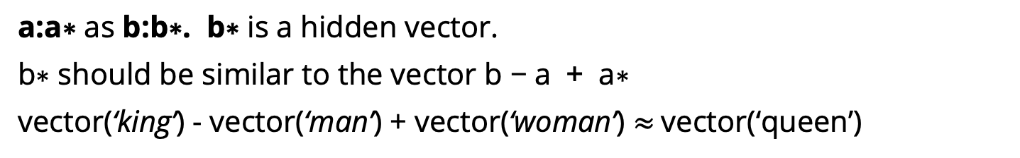
Vector Arithmetic
a:a∗ as b:b∗. b∗ is a hidden vector.
b∗ should be similar to the vector b − a + a∗
vector(‘king’) - vector(‘man’) + vector(‘woman’) $≈$vector(‘queen’)
king
queen
man
woman
Notes:
Analogy Another semantic property of embeddings is their ability to capture re- lational meanings. Mikolov et al. (2013b) and Levy and Goldberg (2014b) show that the offsets between vector embeddings can capture some analogical relations between words. For example, the result of the expression vector(‘king’) - vec- tor(‘man’) + vector(‘woman’) is a vector close to vector(‘queen’); the left panel in Fig. 6.14 visualizes this, again projected down into 2 dimensions. Similarly, they found that the expression vector(‘Paris’) - vector(‘France’) + vector(‘Italy’) results in a vector that is very close to vector(‘Rome’).

Slide 39
Analogy: Embeddings capture relational meaning!
a:a∗ as b:b∗. b∗ is a hidden vector.
b∗ should be similar to the vector b − a + a∗
vector(‘king’) - vector(‘man’) + vector(‘woman’) $≈$vector(‘queen’)
king
-man
+woman
queen
man
woman
Notes:
Analogy Another semantic property of embeddings is their ability to capture re- lational meanings. Mikolov et al. (2013b) and Levy and Goldberg (2014b) show that the offsets between vector embeddings can capture some analogical relations between words. For example, the result of the expression vector(‘king’) - vec- tor(‘man’) + vector(‘woman’) is a vector close to vector(‘queen’); the left panel in Fig. 6.14 visualizes this, again projected down into 2 dimensions. Similarly, they found that the expression vector(‘Paris’) - vector(‘France’) + vector(‘Italy’) results in a vector that is very close to vector(‘Rome’).

Slide 40
Vector Arithmetic
a:a∗ as b:b∗. b∗ is a hidden vector.
b∗ should be similar to the vector b − a + a∗
vector(‘king’) - vector(‘man’) + vector(‘woman’) $≈$vector(‘queen’)
king
-man
+woman
queen
man
woman
So the analogy question can be solved by optimizing:
Notes:
Analogy Another semantic property of embeddings is their ability to capture re- lational meanings. Mikolov et al. (2013b) and Levy and Goldberg (2014b) show that the offsets between vector embeddings can capture some analogical relations between words. For example, the result of the expression vector(‘king’) - vec- tor(‘man’) + vector(‘woman’) is a vector close to vector(‘queen’); the left panel in Fig. 6.14 visualizes this, again projected down into 2 dimensions. Similarly, they found that the expression vector(‘Paris’) - vector(‘France’) + vector(‘Italy’) results in a vector that is very close to vector(‘Rome’).

Slide 41
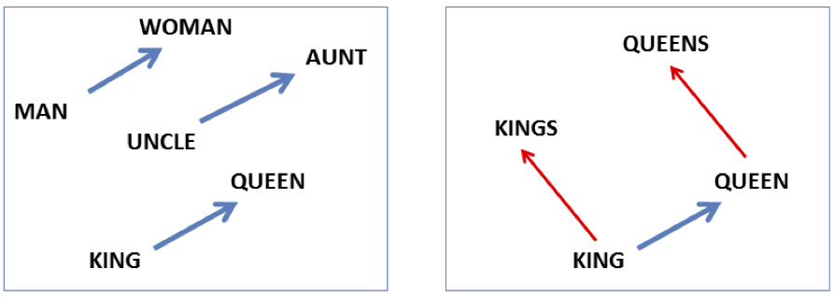
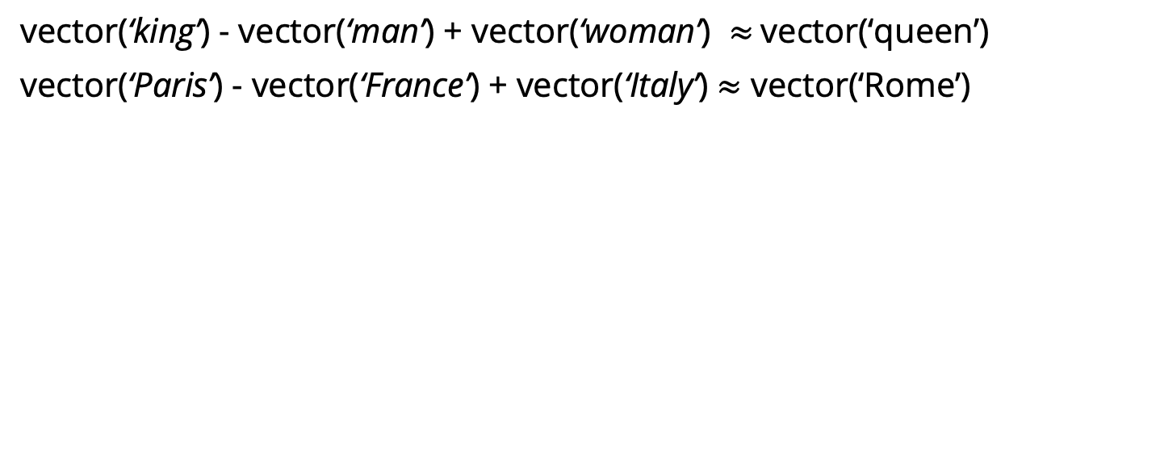
Analogy: Embeddings capture relational meaning!
vector(‘king’) - vector(‘man’) + vector(‘woman’) $≈$vector(‘queen’)
vector(‘Paris’) - vector(‘France’) + vector(‘Italy’) $≈$ vector(‘Rome’)
Notes:
Analogy Another semantic property of embeddings is their ability to capture relational meanings. Mikolov et al. (2013b) and Levy and Goldberg (2014b) show that the offsets between vector embeddings can capture some analogical relations between words. For example, the result of the expression vector(‘king’) - vec- tor(‘man’) + vector(‘woman’) is a vector close to vector(‘queen’); the left panel in Fig. 6.14 visualizes this, again projected down into 2 dimensions. Similarly, they found that the expression vector(‘Paris’) - vector(‘France’) + vector(‘Italy’) results in a vector that is very close to vector(‘Rome’).

Slide 42
Vector Arithmetic
If all word-vectors are normalized to unit length then
is equivalent to
Notes:
This means that solving analogy questions with vector arithmetic is mathematically equivalent to seeking a word (b∗) which is similar to b and a∗ but is different from a. Relational similarity is thus expressed as a sum of attributional similarities.
attributional similarities between vocabulary items means that words that appear in similar contexts will be close to each other in the projected space

Slide 43
Vector Arithmetic
Alternatively, we can require that the direction of the transformation be maintained.
This basically means that b∗ − b shares the same direction with a∗ − a, ignoring the distances
Notes:
Levy and Goldberg refer to this method as PAIRDIRECTION.
In this study, we show that similarly to the neural embedding space, the explicit vector space also encodes a vast amount of relational similar- ity which can be recovered in a similar fashion, suggesting the explicit vector space representation as a competitive baseline for further work on neu- ral embeddings

Slide 44
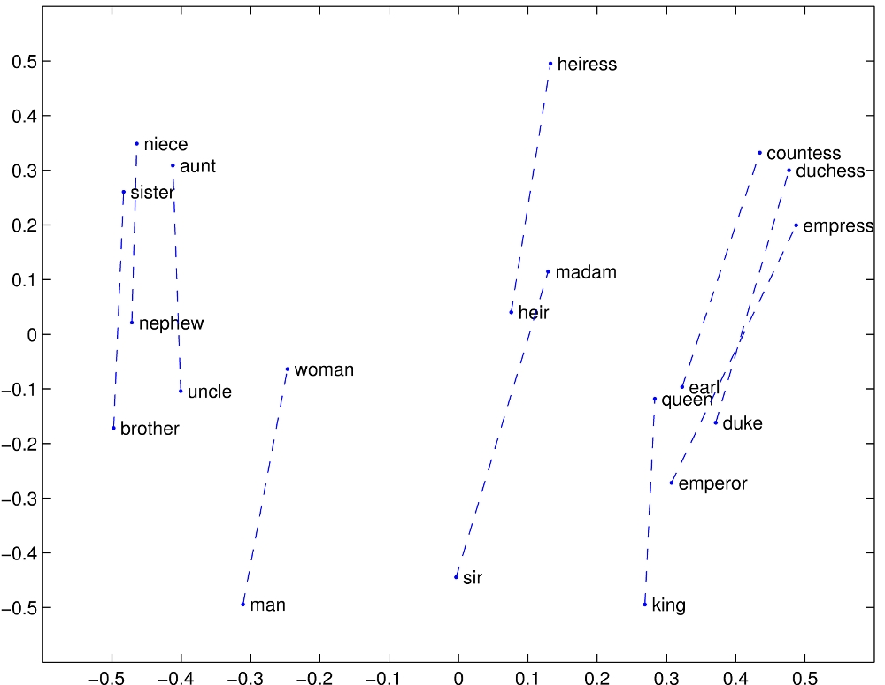
Notes:
Relational properties of the vector space, shown by projecting vectors onto two dimensions. (a) ’king’ - ’man’ + ’woman’ is close to ’queen’

Slide 45
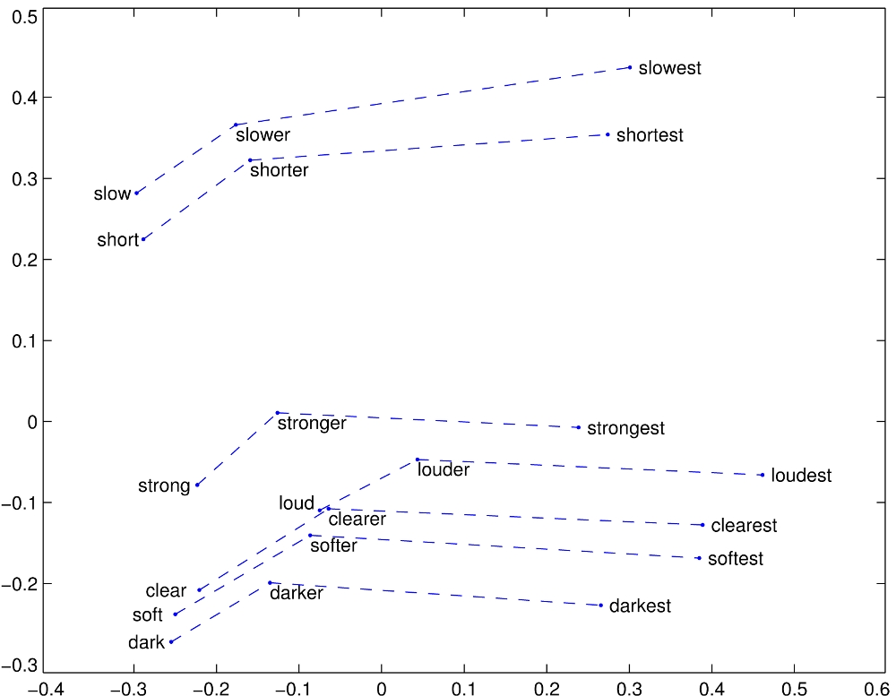
Notes:
Relational properties of the vector space,
offsets seem to capture comparative and superlative morphology (Pennington et al., 2014).

Slide 46
Representing Phrases with vectors
Mikolov et al constructed representations for phrases as well as for individual words.
To learn vector representations for phrases, they first find words that appear frequently together but infrequently in other contexts, and represent these n-grams as single tokens.
For example, “New York Times” and “Toronoto Maple Leafs” are replaced by New_York_Times and Toronoto_Maple_Leafs, but a bigram like “this is” remains unchanged.
Notes:
The δ is used as a discounting coefficient and prevents too many phrases consisting of very infre- quent words to be formed. The bigrams with score above the chosen threshold are then used as phrases. Typically, we run 2-4 passes over the training data with decreasing threshold value, allow- ing longer phrases that consists of several words to be formed.

Slide 47
Analogical reasoning task for phrases

Slide 48
Vector compositionality
Mikolov et al experiment with using element-wise addition to compose vectors
Notes:
CCB – try some out in Magnitude

Slide 49
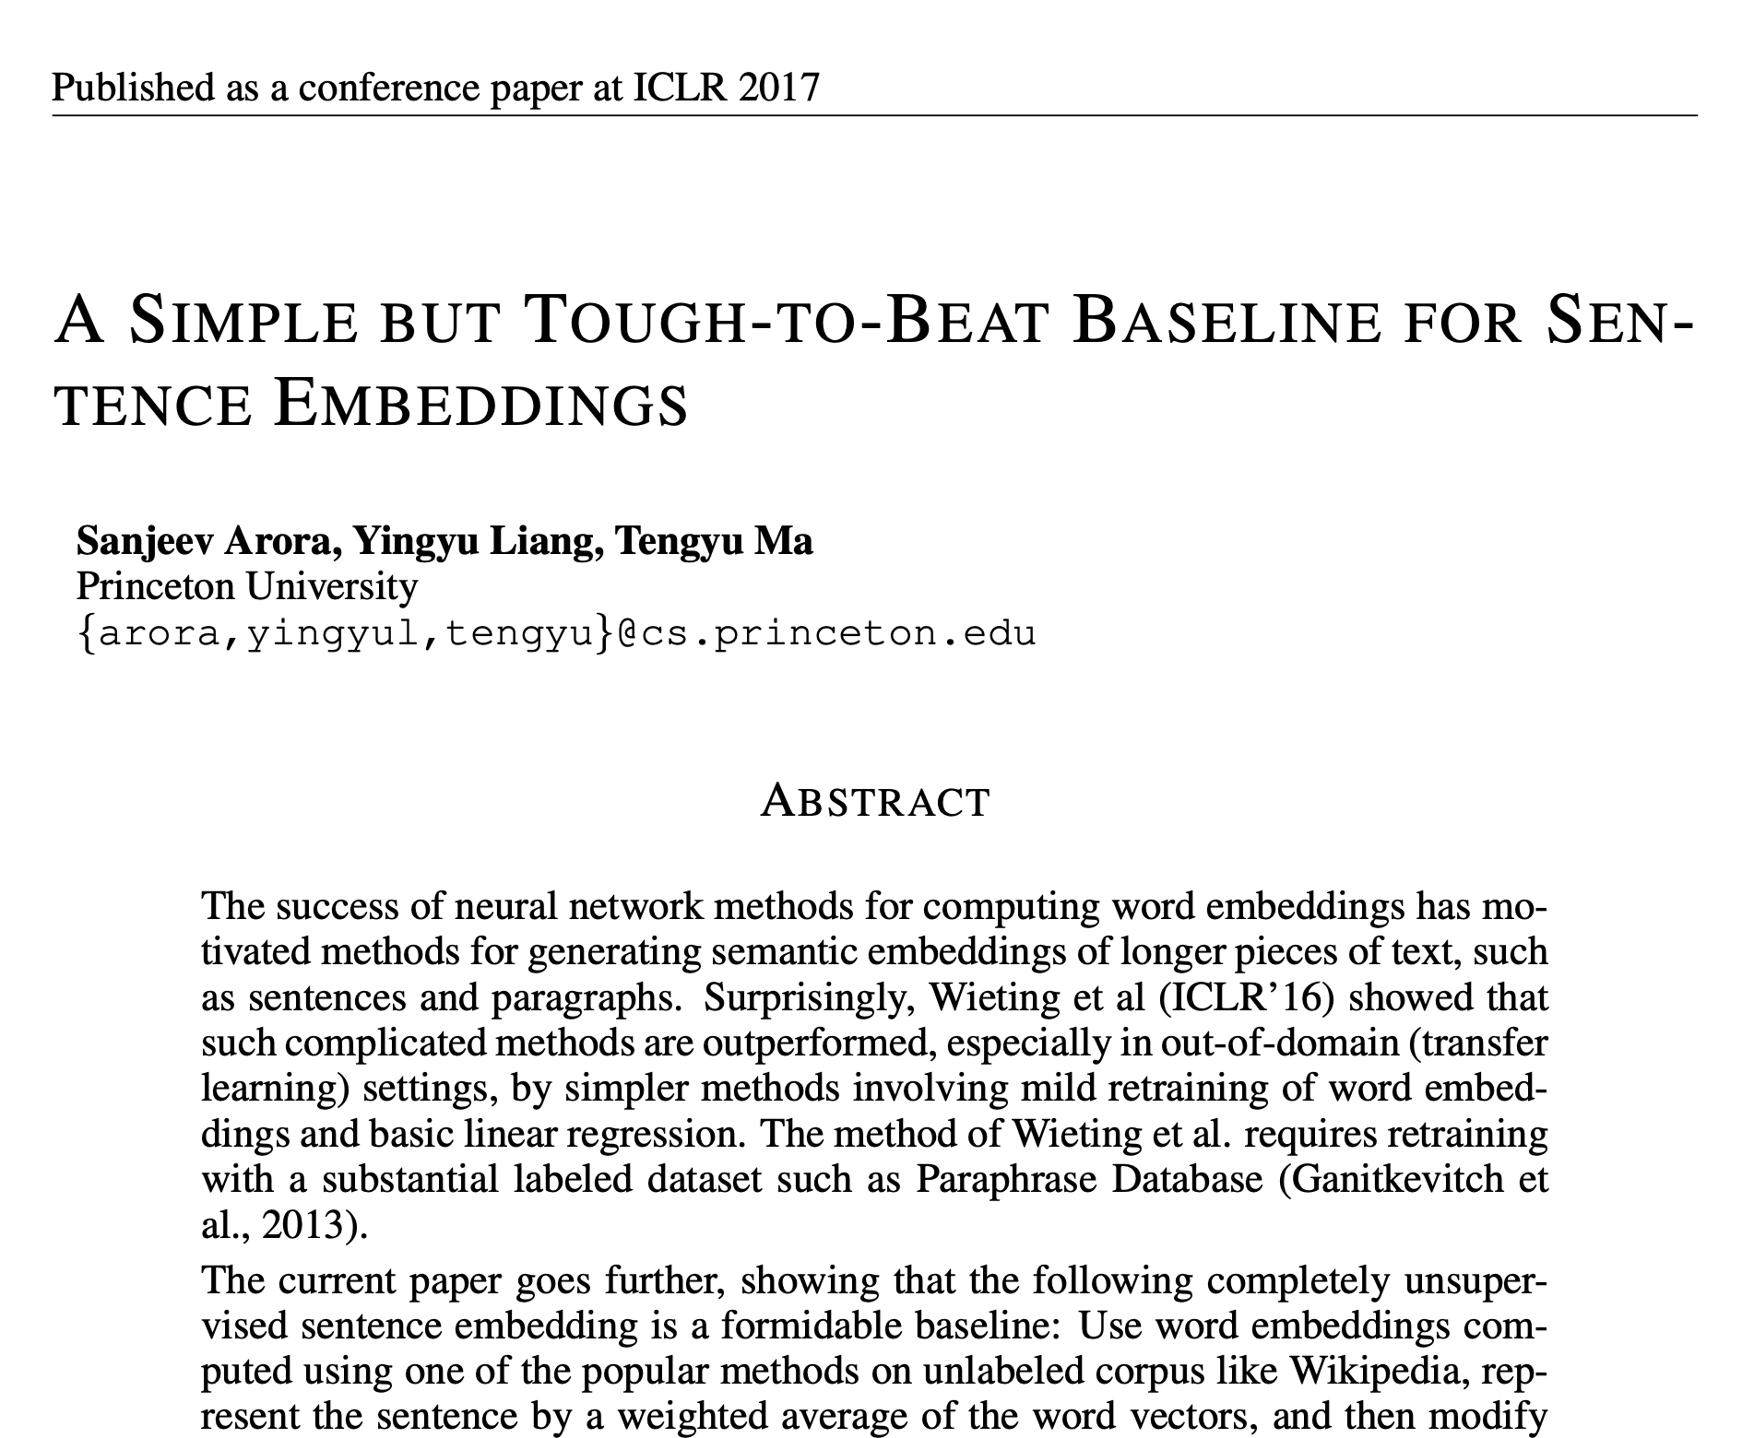

Slide 50

Embeddings can help study word history!
Train embeddings on old books to study changes in word meaning!!
Dan Jurafsky
Will Hamilton
Notes:
Embeddings and Historical Semantics: Embeddings can also be a useful tool for studying how meaning changes over time, by computing multiple embedding spaces, each from texts written in a particular time period. For example Fig. 6.15 shows a visualization of changes in meaning in English words over the last two centuries, computed by building separate embedding spaces for each decade from historical corpora like Google N-grams (Lin et al., 2012) and the Corpus of Histori- cal American English (Davies, 2012).

Slide 51


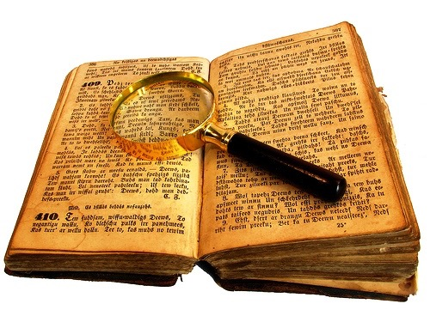
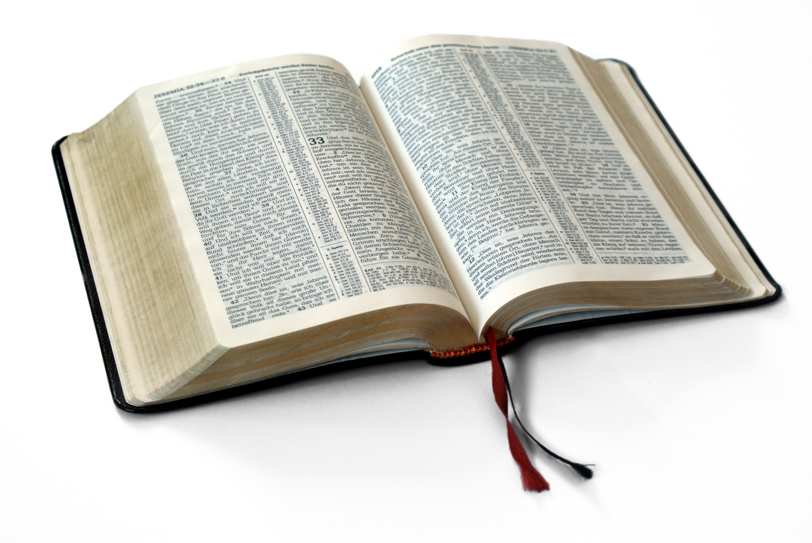
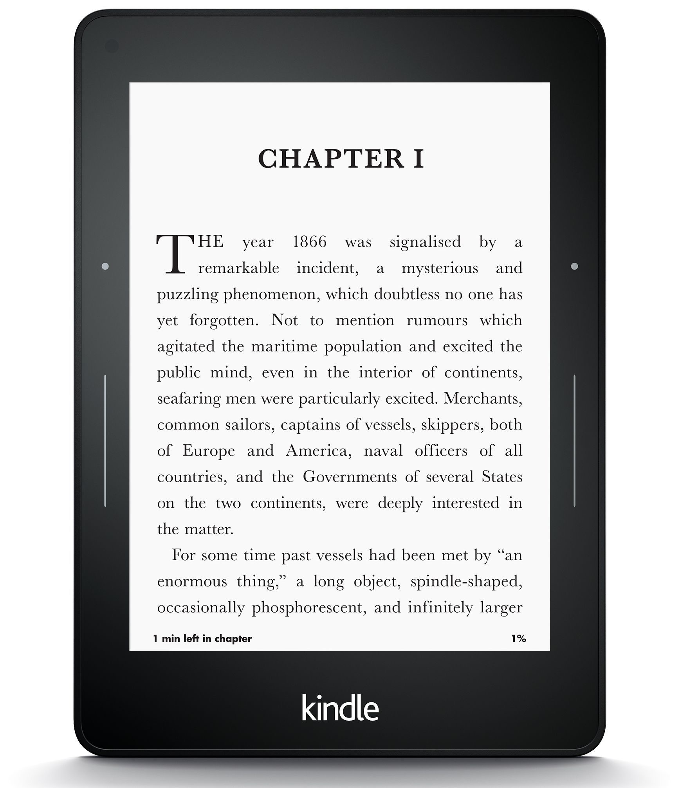
Diachronic word embeddings for studying language change!
Word vectors for 1920
Word vectors 1990
“dog” 1990 word vector
“dog” 1920 word vector
vs.
1900
1950
2000
￼
￼
Notes:
di·a·chron·ic | ˌdīəˈkränik |
adjective
concerned with the way in which something, especially language, has developed and evolved through time. linguistic change is the diachronic aspect of linguistic variation.

Slide 52
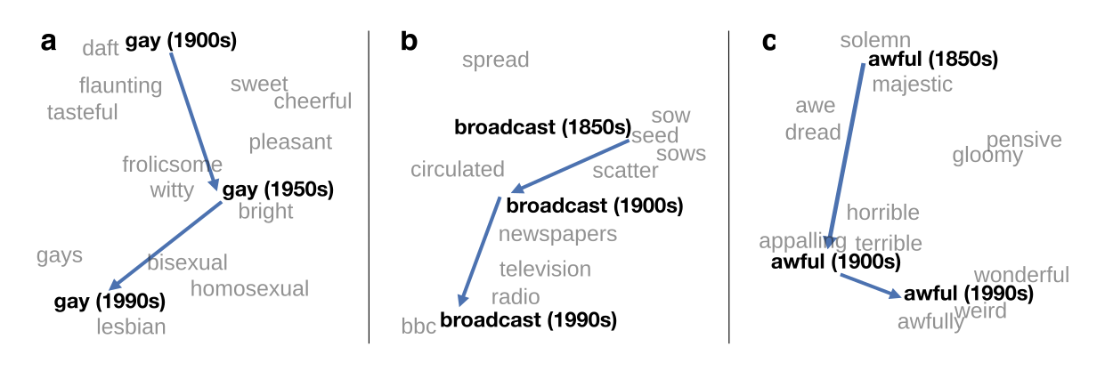
Visualizing changes
Project 300 dimensions down into 2
~30 million books, 1850-1990, Google Books data
Notes:
visualization of the semantic change of 3 words in English using
Figure 5à: Two-dimensional visualization of semantic change in English using SGNS word2vec vectors. The modern sense of each word, and the grey context words, are com-
vectors see Section 5à8 for the visualization algorithm à A, The word gay shifted puted from the most recent (modern) time-point embedding space. Earlier points are com-
from meaning ÒcheerfulÓ or ÒfrolicsomeÓ to referring to homosexualityà A, In the early puted from earlier historical embedding spaces. The visualizations show the changes in the
2àth century broadcast referred to Òcasting out seedsÓà with the rise of television and word gay from meanings related to “cheerful” or “frolicsome” to referring to homosexuality,
radio its meaning shifted to Òtransmitting signalsÓà C, Awful underwent a process of the development of the modern “transmission” sense of broadcast from its original sense of
pejoration, as it shifted from meaning Òfull of aweÓ to meaning Òterrible or appallingÓ
sowing seeds, and the pejoration of the word awful as it shifted from meaning “full of awe” t2om2eàaning “terrible or appalling”

Slide 53
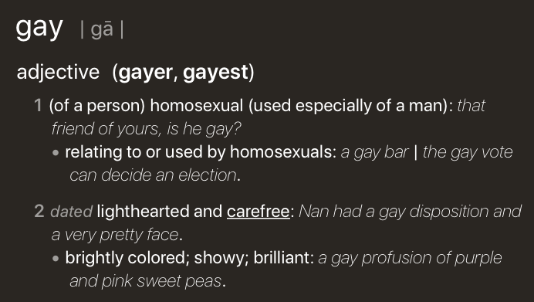
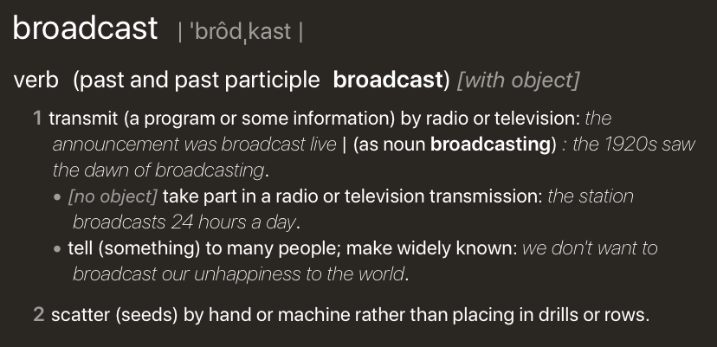
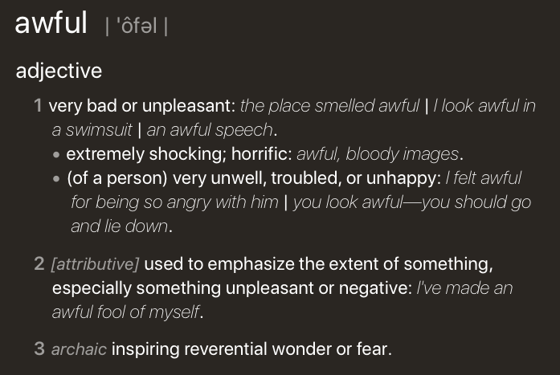
Visualizing changes
Project 300 dimensions down into 2
~30 million books, 1850-1990, Google Books data
Notes:
visualization of the semantic change of 3 words in English using
Figure 5à: Two-dimensional visualization of semantic change in English using SGNS word2vec vectors. The modern sense of each word, and the grey context words, are com-
vectors see Section 5à8 for the visualization algorithm à A, The word gay shifted puted from the most recent (modern) time-point embedding space. Earlier points are com-
from meaning ÒcheerfulÓ or ÒfrolicsomeÓ to referring to homosexualityà A, In the early puted from earlier historical embedding spaces. The visualizations show the changes in the
2àth century broadcast referred to Òcasting out seedsÓà with the rise of television and word gay from meanings related to “cheerful” or “frolicsome” to referring to homosexuality,
radio its meaning shifted to Òtransmitting signalsÓà C, Awful underwent a process of the development of the modern “transmission” sense of broadcast from its original sense of
pejoration, as it shifted from meaning Òfull of aweÓ to meaning Òterrible or appallingÓ
sowing seeds, and the pejoration of the word awful as it shifted from meaning “full of awe” t2om2eàaning “terrible or appalling”

Slide 54
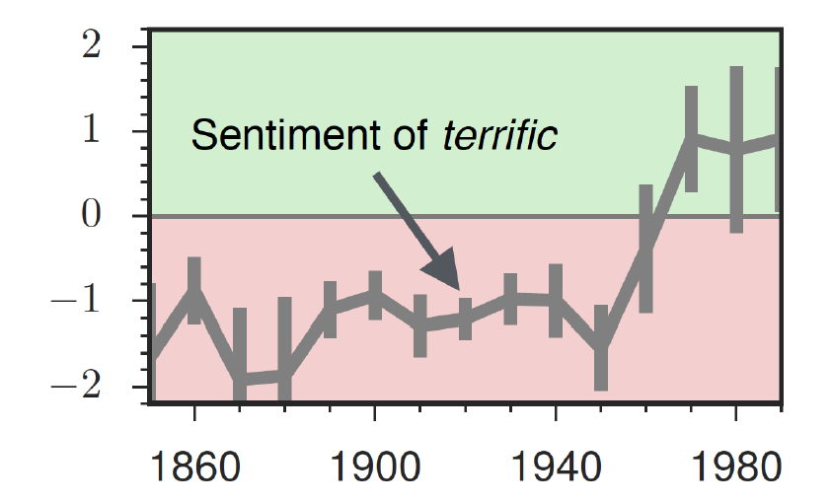
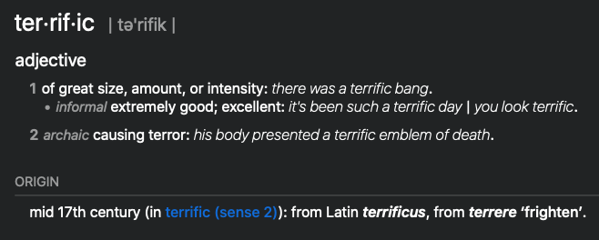
The evolution of sentiment words

Slide 55
Embeddings and bias
Notes:
In addition to their ability to learn word meaning from text, embeddings, alas, also
indicating surprise disbelief à
reproduce the implicit biases and stereotypes that were latent in the text. Recall that
embeddings model analogical relations; ‘queen’ as the closest word to ’king’ - ’man’
+ ’woman’ implies the analogy man:woman::king:queen. But embedding analogies 5à2à2 Computational linguistic studies
also exhibit gender stereotypes.

Slide 56
Embeddings reflect cultural bias
Bolukbasi, Tolga, Kai-Wei Chang, James Y. Zou, Venkatesh Saligrama, and Adam T. Kalai. "Man is to computer programmer as woman is to homemaker? debiasing word embeddings." In Advances in Neural Information Processing Systems, pp. 4349-4357. 2016.
Ask “Paris : France :: Tokyo : x”
x = Japan
Ask “father : doctor :: mother : x”
x = nurse
Ask “man : computer programmer :: woman : x”
x = homemaker
Notes:
For example Bolukbasi et al. (2016) find that the closest occupation to ‘man’ - ‘computer programmer’ + ‘woman’ in word2vec em-
There are also a number of recent works analyzing semantic change using computational
beddings trained on news text is ‘homemaker’, and that the embeddings similarly
methodsà 2àà use latent semantic analysis to analyze how word meanings broaden
suggest the analogy ‘father’ is to ‘doctor’ as ‘mother’ is to ‘nurse’. Algorithms that
and narrow over timeà 3 use raw co-occurrence vectors to perform a number of
used embeddings as part of an algorithm to search for potential programmers or
historical case-studies on semantic change, and 252 perform a similar set of small-
doctors might thus incorrectly downweight documents with women’s names.

Slide 57
Measuring cultural bias
Implicit Association test (Greenwald et al 1998): How associated are
concepts (flowers, insects) & attributes (pleasantness, unpleasantness)?
Studied by measuring timing latencies for categorization.
Psychological findings on US participants:
African-American names are associated with unpleasant words (more than European-American names)
Male names associated more with math, female names with arts
Old people's names with unpleasant words, young people with pleasant words.
Notes:
Roughly speaking, if humans associate ‘flowers’ with ’pleasantness’ and ‘insects’ with ‘unpleasant- ness’, when they are instructed to push a red button for ‘flowers’ (daisy, iris, lilac) and ’pleasant words’ (love, laughter, pleasure) and a green button for ‘insects’ (flea, spider, mosquito) and ‘unpleasant words’ (abuse, hatred, ugly) they are faster than in an incongruous condition where they push a red button for ‘flowers’ and ‘unpleasant words’ and a green button for ‘insects’ and ‘pleasant words
Embeddings also encode the implicit associations that are a property of human
scale case-studies using temporal topic modelsà 8à construct point-wise mutual
reasoning. The Implicit Association Test (Greenwald et al., 1998) measures peo- information-based embeddings and found that semantic changes uncovered by their
ple’s associations between concepts (like ’flowers’ or ’insects’) and attributes (like
method had reasonable agreement with human judgmentsà 29 and 9 use ÒneuralÓ
‘pleasantness’ and ‘unpleasantness’) by measuring differences in the latency with
word-embedding methods to detect linguistic change pointsà Finally, 25à analyze
which they label words in the various categories.6 Using such methods, people in the United States have been shown to associate African-American names with
historical co-occurrences to test whether synonyms tend to change in similar waysà
unpleasant words (more than European-American names), male names more with mathematics and female names with the arts, and old people’s names with unpleas- ant words (Greenwald et al. 1998, Nosek et al. 2002a, Nosek et al. 2002b). Caliskan et al. (2017) replicated all these findings of implicit associations using GloVe vec- tors and cosine similarity instead of human latencies. For example Afrian American names like ‘Leroy’ and ‘Shaniqua’ had a higher GloVe cosine with unpleasant words while European American names (‘Brad’, ‘Greg’, ‘Courtney’) had a higher cosine with pleasant words. Any embedding-aware algorithm that made use of word senti- ment could thus lead to bias against African Americans.

Slide 58
Embeddings reflect cultural bias
Aylin Caliskan, Joanna J. Bruson and Arvind Narayanan. 2017. Semantics derived automatically from language corpora contain human-like biases. Science 356:6334, 183-186.
Caliskan et al. replication with embeddings:
African-American names (Leroy, Shaniqua) had a higher GloVe cosine with unpleasant words (abuse, stink, ugly)
European American names (Brad, Greg, Courtney) had a higher cosine with pleasant words (love, peace, miracle)
Embeddings reflect and replicate all sorts of pernicious biases.
Notes:
Roughly speaking, if humans associate ‘flowers’ with ’pleasantness’ and ‘insects’ with ‘unpleasant- ness’, when they are instructed to push a red button for ‘flowers’ (daisy, iris, lilac) and ’pleasant words’ (love, laughter, pleasure) and a green button for ‘insects’ (flea, spider, mosquito) and ‘unpleasant words’ (abuse, hatred, ugly) they are faster than in an incongruous condition where they push a red button for ‘flowers’ and ‘unpleasant words’ and a green button for ‘insects’ and ‘pleasant words
Embeddings also encode the implicit associations that are a property of human
scale case-studies using temporal topic modelsà 8à construct point-wise mutual
reasoning. The Implicit Association Test (Greenwald et al., 1998) measures peo- information-based embeddings and found that semantic changes uncovered by their
ple’s associations between concepts (like ’flowers’ or ’insects’) and attributes (like
method had reasonable agreement with human judgmentsà 29 and 9 use ÒneuralÓ
‘pleasantness’ and ‘unpleasantness’) by measuring differences in the latency with
word-embedding methods to detect linguistic change pointsà Finally, 25à analyze
which they label words in the various categories.6 Using such methods, people in the United States have been shown to associate African-American names with
historical co-occurrences to test whether synonyms tend to change in similar waysà
unpleasant words (more than European-American names), male names more with mathematics and female names with the arts, and old people’s names with unpleas- ant words (Greenwald et al. 1998, Nosek et al. 2002a, Nosek et al. 2002b). Caliskan et al. (2017) replicated all these findings of implicit associations using GloVe vec- tors and cosine similarity instead of human latencies. For example Afrian American names like ‘Leroy’ and ‘Shaniqua’ had a higher GloVe cosine with unpleasant words while European American names (‘Brad’, ‘Greg’, ‘Courtney’) had a higher cosine with pleasant words. Any embedding-aware algorithm that made use of word senti- ment could thus lead to bias against African Americans.

Slide 59
Directions
Debiasing algorithms for embeddings
Bolukbasi, Tolga, Chang, Kai-Wei, Zou, James Y., Saligrama, Venkatesh, and Kalai, Adam T. (2016). Man is to computer programmer as woman is to homemaker? debiasing word embeddings. In Advances in Neural Infor- mation Processing Systems, pp. 4349–4357.
Use embeddings as a historical tool to study bias

Slide 60
Embeddings as a window onto history
Nikhil Garg, Londa Schiebinger, Dan Jurafsky, and James Zou, (2018). Word embeddings quantify 100 years of gender and ethnic stereotypes. Proceedings of the National Academy of Sciences, 115(16), E3635–E3644
Use the Hamilton historical embeddings
The cosine similarity of embeddings for decade X for occupations (like teacher) to male vs female names
Is correlated with the actual percentage of women teachers in decade X

Slide 61
History of biased framings of women
Nikhil Garg, Londa Schiebinger, Dan Jurafsky, and James Zou, (2018). Word embeddings quantify 100 years of gender and ethnic stereotypes. Proceedings of the National Academy of Sciences, 115(16), E3635–E3644
Embeddings for competence adjectives are biased toward men
Smart, wise, brilliant, intelligent, resourceful, thoughtful, logical, etc.
This bias is slowly decreasing

Slide 62
Princeton Trilogy experiments
Study 1: Katz and Braley (1933)
Investigated whether traditional social stereotypes had a cultural basis
Ask 100 male students from Princeton University to choose five traits that characterized different ethnic groups (for example Americans, Jews, Japanese, Negroes) from a list of 84 word
84% of the students said that Negroes were superstitious and 79% said that Jews were shrewd. They were positive towards their own group.
Study 2: Gilbert (1951) Less uniformity of agreement about unfavorable traits than in 1933.
Study 3: Karlins et al. (1969)
Many students objected to the task but this time there was greater agreement on the stereotypes assigned to the different groups compared with the 1951 study. Interpreted as a re-emergence of social stereotyping but in the direction more favorable stereotypical images.
Notes:
Study 1: Katz and Braley (1933)
Investigated whether traditional social stereotypes had a cultural basis by asking 100 male students from Princeton University to choose five traits that characterized different ethnic groups (for example Americans, Jews, Japanese, Negroes) from a list of 84 words. The results showed considerable agreement in stereotypes, especially of negative traits. Eighty-four per cent of the students said that Negroes were superstitious and 79% said that Jews were shrewd. They were very positive towards their own group (ingroup bias). Since most of the students did not have any personal contact with members of the ethnic groups they had to rate, it was suggested that stereotypes are learned (e.g. through the media or by gatekeepers, i.e. they are cultural products).
Study 2: Gilbert (1951)
Replicated the study of Princeton students. This time there was less uniformity of agreement, especially about unfavorable traits, than in the 1933 study. The stereotypes still demonstrated an ingroup bias. Stereotypes about Japanese were extremely negative and this was explained by the negative press about Japan after Pearl Harbor, so the original hypothesis about stereotypes as cultural products was confirmed. Many students expressed irritation at being asked to make generalizations at all and this could indicate a social change (e.g. that it was no longer as acceptable to express stereotypes openly).
Study 3: Karlins et al. (1969)
Replicated the study. Many students objected to the task but this time there was greater agreement on the stereotypes assigned to the different groups compared with the 1951 study. The researchers interpreted this as a re-emergence of social stereotyping but in the direction of a more favorable stereotypical image.

Slide 63
Embeddings reflect ethnic stereotypes over time
Nikhil Garg, Londa Schiebinger, Dan Jurafsky, and James Zou, (2018). Word embeddings quantify 100 years of gender and ethnic stereotypes. Proceedings of the National Academy of Sciences, 115(16), E3635–E3644
Princeton trilogy experiments
Attitudes toward ethnic groups (1933, 1951, 1969) scores for adjectives
industrious, superstitious, nationalistic, etc
Cosine of Chinese name embeddings with those adjective embeddings correlates with human ratings.
Notes:
Study 1: Katz and Braley (1933)
Investigated whether traditional social stereotypes had a cultural basis by asking 100 male students from Princeton University to choose five traits that characterized different ethnic groups (for example Americans, Jews, Japanese, Negroes) from a list of 84 words. The results showed considerable agreement in stereotypes, especially of negative traits. Eighty-four per cent of the students said that Negroes were superstitious and 79% said that Jews were shrewd. They were very positive towards their own group (ingroup bias). Since most of the students did not have any personal contact with members of the ethnic groups they had to rate, it was suggested that stereotypes are learned (e.g. through the media or by gatekeepers, i.e. they are cultural products).
Study 2: Gilbert (1951)
Replicated the study of Princeton students. This time there was less uniformity of agreement, especially about unfavorable traits, than in the 1933 study. The stereotypes still demonstrated an ingroup bias. Stereotypes about Japanese were extremely negative and this was explained by the negative press about Japan after Pearl Harbor, so the original hypothesis about stereotypes as cultural products was confirmed. Many students expressed irritation at being asked to make generalizations at all and this could indicate a social change (e.g. that it was no longer as acceptable to express stereotypes openly).
Study 3: Karlins et al. (1969)
Replicated the study. Many students objected to the task but this time there was greater agreement on the stereotypes assigned to the different groups compared with the 1951 study. The researchers interpreted this as a re-emergence of social stereotyping but in the direction of a more favorable stereotypical image.

Slide 64
Change in linguistic framing 1910-1990
Nikhil Garg, Londa Schiebinger, Dan Jurafsky, and James Zou, (2018). Word embeddings quantify 100 years of gender and ethnic stereotypes. Proceedings of the National Academy of Sciences, 115(16), E3635–E3644
Change in association of Chinese names with adjectives framed as "othering" (barbaric, monstrous, bizarre)
Notes:
This shows the relative strength of the Asian association for words used to describe outsiders over time. As opposed to the adjectives overall, which see two distinct phase shifts in Asian association, the words related to outsiders steadily decrease in Asian association over time—except around World War II—indicating that broader globalization trends led to changing attitudes with regard to such negative portrayals. Overall, the word embeddings exhibit a remarkable change in adjectives and attitudes toward Asian Americans during the 20th century.

Slide 65
Changes in framing: adjectives associated with Chinese
Nikhil Garg, Londa Schiebinger, Dan Jurafsky, and James Zou, (2018). Word embeddings quantify 100 years of gender and ethnic stereotypes. Proceedings of the National Academy of Sciences, 115(16), E3635–E3644

Slide 66
Conclusion
Embeddings = vector models of meaning
More fine-grained than just a string or index
Especially good at modeling similarity/analogy
Just download them and use cosines!!
Can use sparse models (tf-idf) or dense models (word2vec, GLoVE)
Useful in practice but know they encode cultural stereotypes

